Slide 1
Malaysian Experience of Developing Islamic Finance as a potential model to adopt in Uzbekistan
Hayot AZIMOVCIFP, ACI
14 March 2023

Slide 2
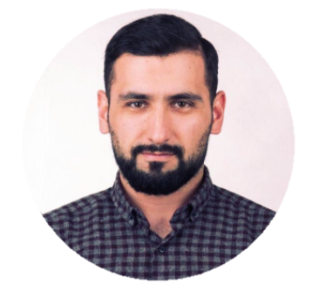
Hayot AZIMOV CIFP, ACI
Chartered Islamic Finance Professional (2007) - INCEIF (Malaysia)
Product Structurer, BNP Paribas Najmah (Malaysia)
Member of Capital Markets & Treasury Committee – AIBIM (Malaysia)
Portfolio:
+20 Islamic Finance Products
+1.5 Bn USD Transacted

Slide 3
Malaysian Islamic Finance Market
Takaful penetration – 19% - USD 330 Mn
Islamic Banking penetration – 41% - USD 254 Bn
Sukuk – 45% of Global total issuance
Islamic Securities Market Cap - USD 250Bn
Islamic Interbank Market, Islamic Risk Hedging products, Islamic Structured Products
Robust Regulatory Framework & Policy Mechanisms
Source: Fitch Ratings, IFN
Differentiating factors:
Institutionalized & Systemic Approach
Focus on value creation vs consumption
Success factors:
Political Will / “Tone at the top”
Well functioning Debt Capital Markets
Notes:
As we are at the initial stage of developing Islamic Finance in Uzbekistan, good to consider various countries and their path so far.
While there are dozen of countries who have build sizable Islamic Finance assets, Malaysian market stands head & shoulders among them.
See the numbers.
1. Institutionalized & Systemic means integration of Shariah advisory & compliance roles at financial institution as well as the regulatory level
2. Islamic Finance is still a finance, hence it is important to finance the value creation rather than buying that latest iPhone with halal installment plan.
Key conclusion is that Uzbekistan can make 10X moonshot with a right model to adopt.
It will take less time to achieve what Malaysia has done.

Slide 4
Uzbekistan Islamic Finance landscape
Regulated Financial Institutions:
Apex Oila Takaful – First Regulated Financial Institution to provide fixed income returns.
Trast Muamalat IBW, Islamic lines of finance by DFIs & Supras
Other non bank players – Uzaro, Alif, Iman, Texnomart, Ishonch, etc…
Assets | Liabilities
Fixed Income | Fixed Income
Assets | Liabilities
Fixed Income | Profit Sharing
Absence of Islamic DCM is impeding the growth of Islamic Finance in Uzbekistan
Notes:
Whilst landscape looks like a good start, demand is mainly met on the retail consumer financing
Business financing is still at its infancy due to absence of DCM instruments.

Slide 5
The Way Forward
Compliment Islamic Finance ecosystem with Islamic DCM
Islamic Finance activities to focus on institutionalized value creation
Mindset change → From ad-hoc fatwas to robust institutional Shariah governance

Slide 6
THANK YOU
Hayotjon AZIMOV_{CIFP, ACI}
hayotjon@azimovbizconsult.uz

